Slide 1
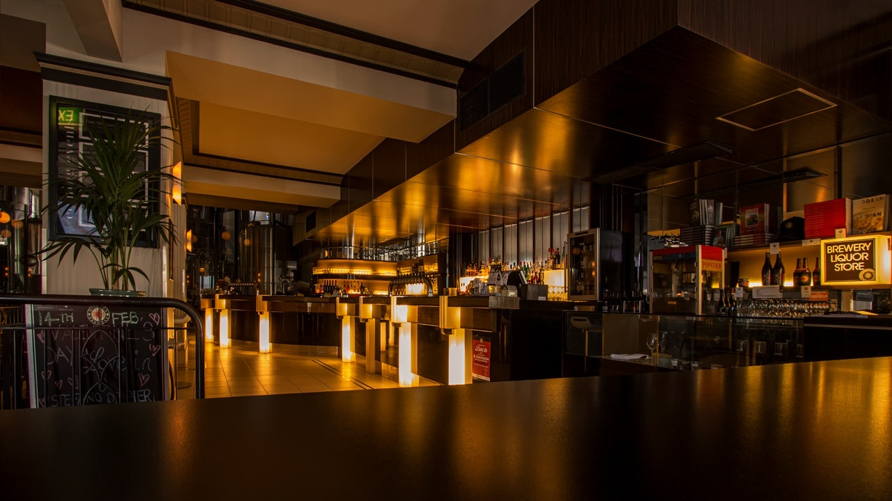

Since
2022
FOODIFY
www.websiteexample.com
Notes:
Links:
https://www.pexels.com/photo/alcohol-architecture-bar-beer-260922/

Slide 2
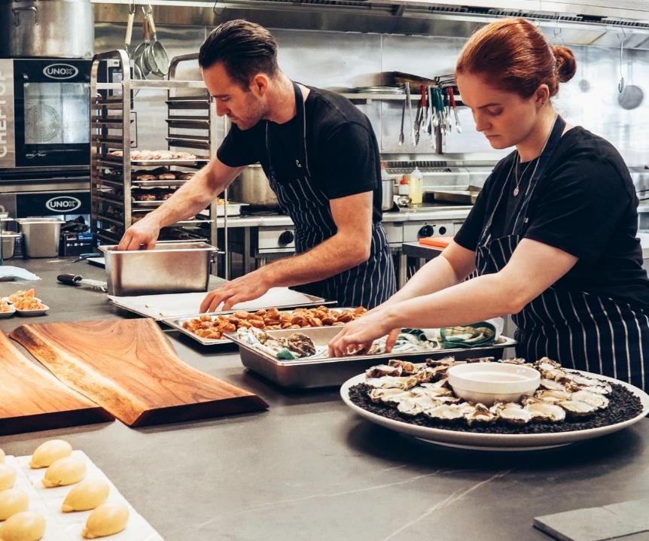


BACKGROUND
Presentations are communication tools that can be used as demonstrations, lectures, speeches, reports, and more.
Notes:
Links:
https://www.pexels.com/photo/chef-holding-white-tea-cup-887827/https://www.pexels.com/photo/chef-holding-white-tea-cup-887827/

Slide 3

PROBLEM STATEMENT
The method dramatically streamlines the ordering procedure for both the consumer and the restaurant, as well as significantly reducing the establishment's workload. The system will also automatically compute and show the final bill, ensuring that the bills are ready to print with no errors because the information for that item has already been entered.
Notes:
Links:
https://www.pexels.com/photo/pendant-bulb-photo-750843/

Slide 4
SIGNIFICANCE OF PROBLEM
The inspiration for creating this application came from the fact that I dislike waiting in restaurants for long periods of time or having to call restaurants to place an order, especially when I am extremely hungry, and that some people are hesitant to ask detailed menu information such as price and so on. Even though I dislike it, it will allow us to skip the long lines at the desk.
Notes:
Links:
https://www.pexels.com/photo/pendant-bulb-photo-750843/

Slide 5

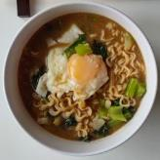
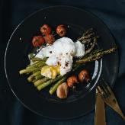
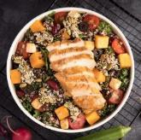
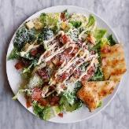
PROPOSED SOLUTION
Based on our discussion of problem statement we propose a solution of developing mobile application which allow users to reserve their tables from home and place their order via QR code scanner. The main reason to build this app is to minimize the workload on restaurant’s staff and customers will not have to wait for a long time to place their order. In our system bills will also paid online by customers.
Notes:
Links:
https://unsplash.com/photos/Orz90t6o0e4
https://www.pexels.com/photo/plate-of-yellow-food-with-green-relish-2297961/
https://www.pexels.com/photo/top-view-photo-of-food-on-top-of-baking-rack-2741448/
https://www.pexels.com/photo/salad-on-a-plate-2097090/
https://www.pexels.com/photo/noodle-soup-with-meat-and-vegetables-in-white-ceramic-bowl-4110421/
https://www.pexels.com/photo/noodle-soup-with-meat-and-vegetables-in-white-ceramic-bowl-4110421/
https://www.pexels.com/photo/cooked-food-704569/

Slide 6
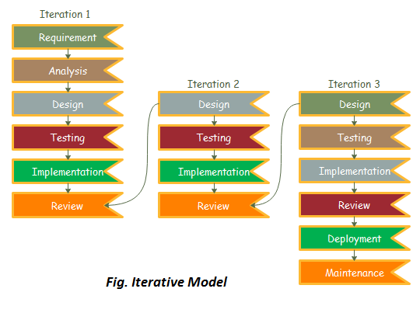
METHODOLOGY
In software engineering, development
methodology is known as software
development life cycle (SDLC). For this
project, we decided to use iterative
development as it is more suitable for this
project.

Slide 7





MAIN FEATURES
ONLINE TABLE RESERVATION
ORDER MENU VIA QR CODE
PAYMENT GATEWAY INTEGRATION
ADMIN PANEL
FEEDBACK SYSTEM
Notes:
Links:
https://pixabay.com/illustrations/cook-boy-cooking-kitchen-chef-1773638/

Slide 8


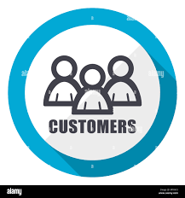

POTENTIAL USERS
OWNERS
STAFF/MANAGERS
CUSTOMERS
CREDITORS/BANKS
Notes:
Links:
https://www.pexels.com/photo/top-view-of-food-1640772/
https://www.pexels.com/photo/close-up-photo-of-a-cheese-burger-1633578/
https://www.pexels.com/photo/burrito-chicken-delicious-dinner-461198/
https://www.pexels.com/photo/blur-breakfast-close-up-dairy-product-376464/

Slide 9
THANK YOU
www.foodify.com
Notes:
Links:
https://www.pexels.com/photo/alcohol-architecture-bar-beer-260922/

